Slide 1
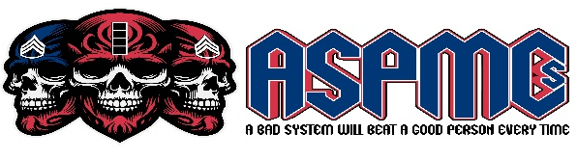



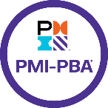


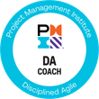
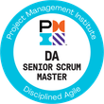
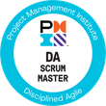








Capability Statement
1440 Dominic Anakin Dr., El Paso, TX 79928 | armyspmcs.com| 915-264-3456
Army Strong PM Consultants LLC is a distinguished SBA, Service-Disabled Veteran-Owned Small Business (SDVOSB), and MBE certified business. We are dedicated to advancing program, project management, and field-level maintenance across public agencies and the U.S. Army. Iron Thunder: “STRIKE FEAR!”
Mission: We apply disciplined agile and process improvement practices to enhance efficiency across diverse organizations. Our expertise ensures clients achieve operational excellence and credible readiness in an ever-changing business landscape..
Vision: To be the benchmark for agile process improvement consultancy, driving innovation and transformative efficiency. We envision a future where our strategic guidance fosters resilience and adaptability in organizations around the globe.
Core Competencies
Utilizing disciplined agile methodologies to assess, redesign, and enhance maintenance and logistics processes. Our strategies focus on improving operational efficiency, reducing downtime, and ensuring project success within budget and time constraints.
Expertise in identifying and eliminating waste within processes and optimizing workflows to enhance efficiency and productivity. Our approach integrates lean principles to streamline operations, reduce costs, and improve service delivery.
Exceptional ability to engage with stakeholders at all levels, implementing effective feedback mechanisms to adapt and improve training programs and operational processes continuously.
Expertise in managing and delivering complex maintenance programs, ensuring strategic alignment with organizational objectives and on-time, within-budget project delivery.
Profound knowledge in implementing Agile and Disciplined Agile practices to foster a culture of continuous improvement, adaptability, and responsiveness to rapidly changing operational needs.
NAICS
541611 – Admin Mgmt
541990 – Prof, Sci, Tech
541512 – IT Mgmt
561110 – Office Mgmt
541513 – IT Systems Mgmt
561499 – Business Spt
541690 – Tech Consult
611430 – Prof, Mgmt Dev Training
Core Profile
UEI | Cage Code | DUNS TZPFNF9HMFE5 | 9T7G6 | 926021820
Founded
2024
Website
armyspm.com
Headquarters
1440 Dominic Anakin Dr., El Paso, TX 79928
Alias/DBA
J.P. PMCS
Small Business Programs
SBA, SDVOSB, VOSB
Differentiators
Founders Individual Certification
Our approach marries disciplined agile methodologies with lean practices to optimize workflows for clients in military and commercial domains. Leveraging our founder's deep-rooted experience and our team's unwavering commitment to quality, we excel in delivering streamlined operations that enhance productivity and performance across sectors.
PMI-PMP, PMI-ACP, PMI-RMP, PMI-PBA, DAC, DAVSC, DASSM, DASM, MPM,CIPM, ITIL Foundation, LSSBB, CSM, CSPO
www.armyspm.com
1

Slide 2


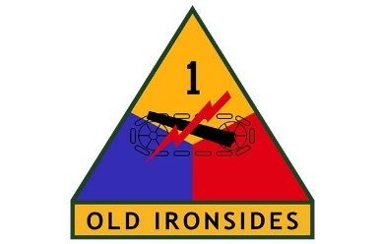


Capability Statement
Past Performance
BAE Systems | IT Project Manager II
Period
February 2022 – Present
Key Responsibilities
Spearheaded cybersecurity and process improvement initiatives; managed IT teams.
Achievements
Achieved a 40% reduction in security incidents, enhancing monitoring protocols and response strategies, and led to a 30% increase in operational efficiency through cross-functional collaboration and effective stakeholder management.
Skills & Technologies Used
Cybersecurity, risk management, and project management software.
U.S. Army | CW4 | 915E
Period
July 2019 – June 2021
Key Responsibilities
Program Portfolio Manager, leading training and digital transformation initiatives.
Achievements
Delivered comprehensive training to over 3000 students, improving course satisfaction by 25%. Spearheaded Agile adoption, enhancing project completion rates by 20%, and led successful cloud migration, reducing costs by 35%.
Army Sustainment
University
Skills & Technologies Used
Agile practices, digital transformation strategies, feedback mechanisms, cloud computing, career transition management.
U.S. Army | CW4 | 915E
Period
July 2017 – June 2019
Key Responsibilities
Program Portfolio Manager, managing a $10M portfolio of ground maintenance programs.
Achievements
Achieved on-time, within-budget delivery of projects, enhancing team productivity by 20%. Implemented cost optimization strategies, reducing maintenance operational costs by 20%, and increased diversity by 20%. And increasing
2nd ABCT 1st AD
Skills & Technologies Used
Budget management, training development, logistics coordination, and asset management.
U.S. Army | CW4 | 913A
Period
July 2015 – June 2017
Key Responsibilities
Project Manager, leading preventative maintenance and training programs.
Achievements
Reduced operational downtime by 15% and increased equipment life expectancy by 25%. led the revision of safety procedures that reduced work-related injuries by 40%.
4-27 FA BN
2nd ABCT 1st AD
Skills & Technologies Used
Preventative maintenance, safety protocols, logistical operations, budget management, and armament system maintenance.
U.S. Army | CW2 | 913A
Period
August 2012 – June 2015
Key Responsibilities
Project Manager, directing ground maintenance projects and preventative maintenance initiatives.
Achievements
Enhanced operational readiness by 15%, boosted armament system longevity by 20%, and reduced system downtimes by 15%. Fostered a 30% increase in team proficiency through training.
1st Brigade
82nd Airborne Division
Skills & Technologies Used
Project scheduling, resource allocation, stakeholder engagement, risk management, logistics for deployments.
www.armyspm.com
2

